Slide 1
Data Science:
Data Science is the process and method for extracting knowledge and insights from large volumes of disparate data.
It's an interdisciplinary field involving mathematics, statistical analysis, data visualization, machine learning, and more.
It's what makes it possible for us to appropriate information, see patterns, find meaning from large volumes of data and use it to make decisions that drive business.
Data Science can use many of the AI techniques to derive insight from data.

Slide 2
Supervised ML(Input and Output) 1)Classification 2) Regression Unsupervised ML(Input) Clustering
Types of ml:

Slide 3
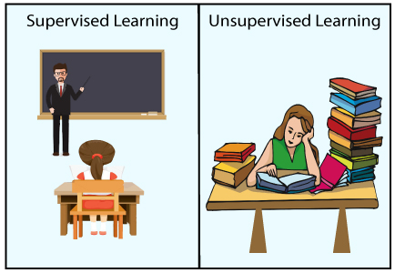
Supervised vs Unsupervised

Slide 4
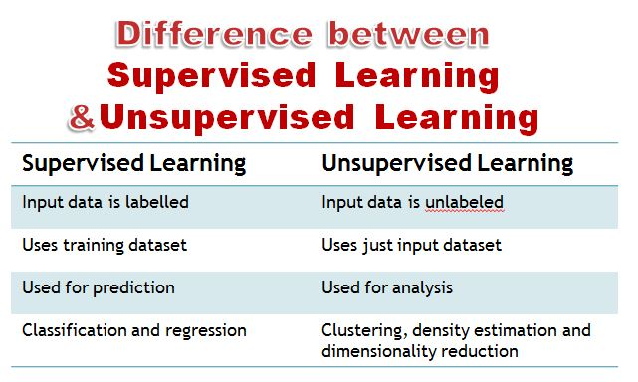

Slide 5
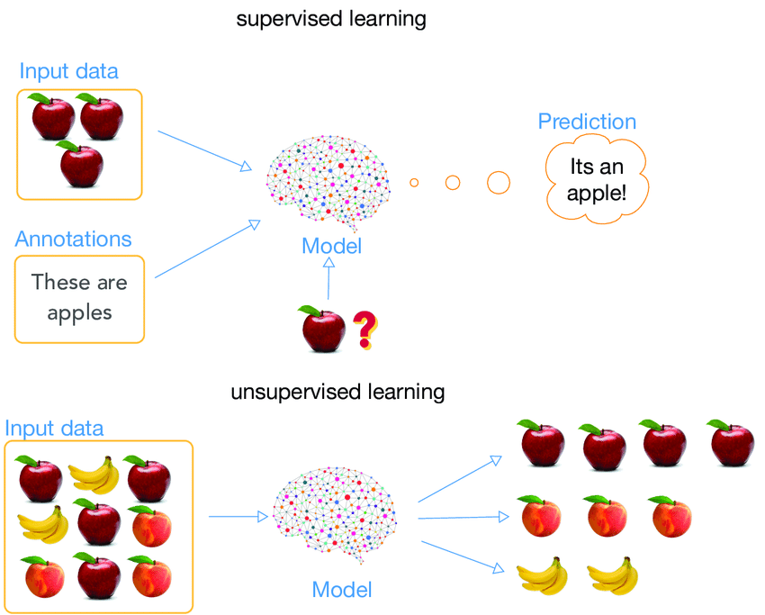

Slide 6
Supervised ML:
In Supervised ML problem, we have features and target column.
Features are INPUT.
Targets are OUTPUT.

Slide 7
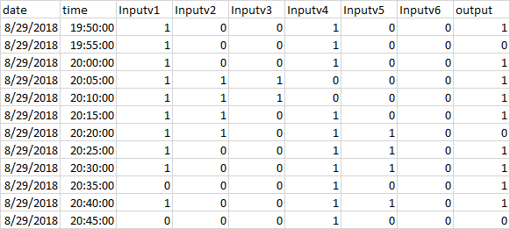
Classification: We classify input data into given classes.

Slide 8
Regression:
We try to predict a continuous value.
We build linear relationship between input variables.
Eg:

Slide 9
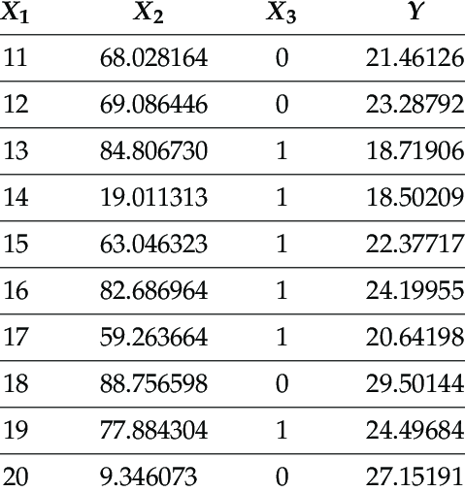
Regression:

Slide 10
Difference between classification & regression:
Regression: Price of house.
Classification: Will it be cold or hot tomorrow

Slide 11
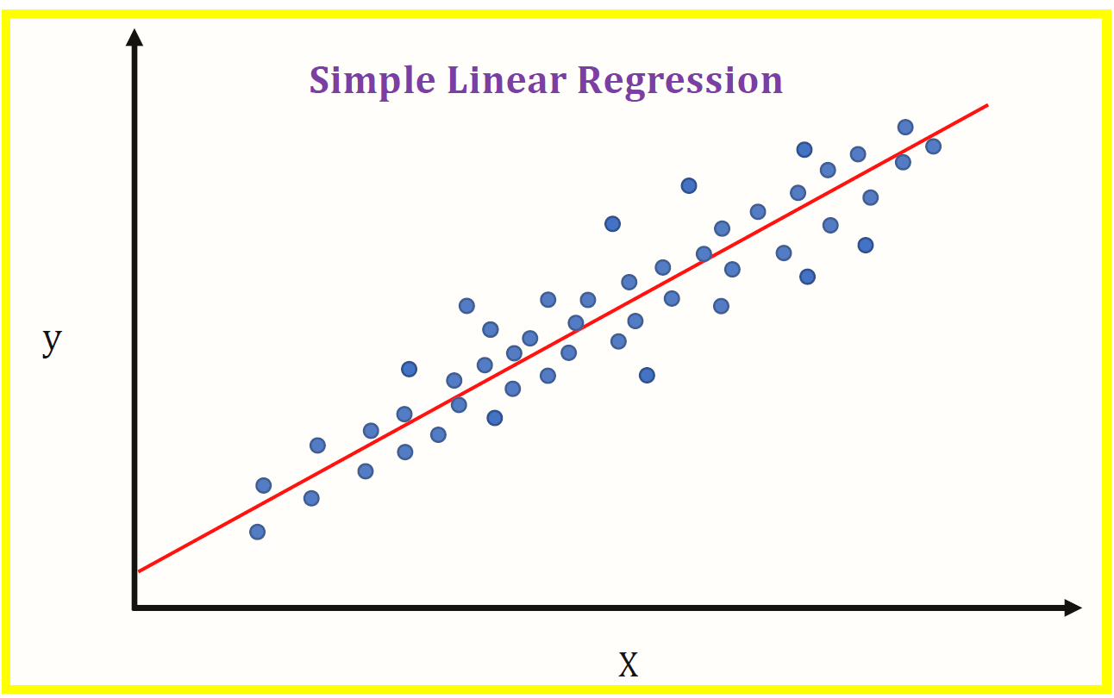
Linear regression:

